Slide 1


INSURANCE
Presented By : Sheetal Kumari
ML Project

Slide 2
Problem Statement
In this Insurance Dataset 'charges' is the Target Variable, Insurance of individual varies with following factors such as age, smoker, bmi, sex, no. of children. In the following data set we are suppose to predict the charges with respect to the factors affecting it.
Finding the ML-Algo which can Predict the Insurance Charges.
What are the parameters which affect the most in insurance charges?
Is there any relation between bmi and smoker with insurance charges ?

Slide 3
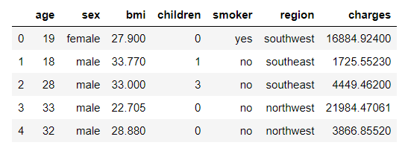
Insurance Data:

Slide 4
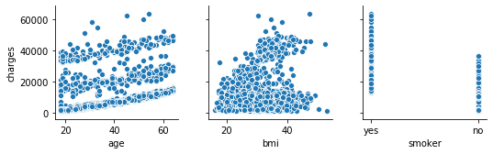
Parameters Effecting Insurance Charges
Charges changes with respect to AGE , BMI and Smoker effecting the insurance price.

Slide 5
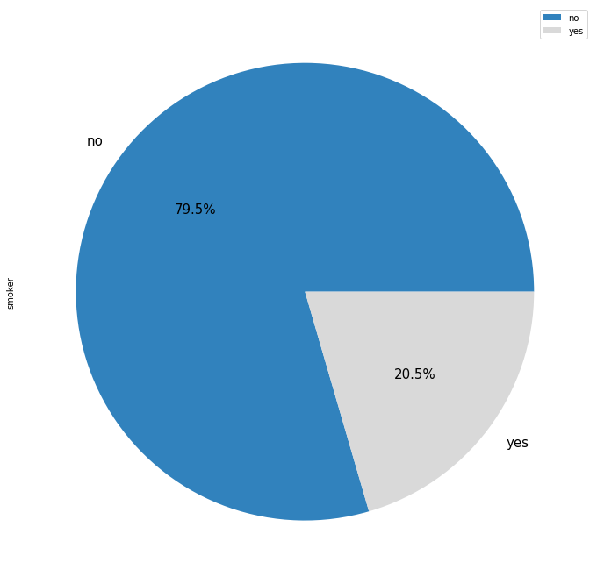

Customers who Smoke ?
The percentage of Non Smokers are High
with 79.5 and the rest 20.5 % is smokers
And the count for the same is as show below

Slide 6
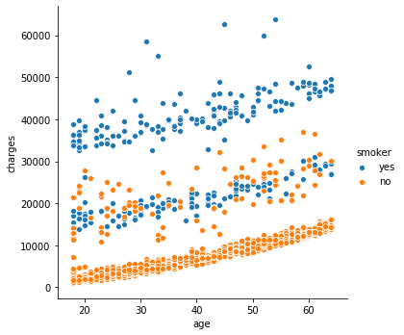
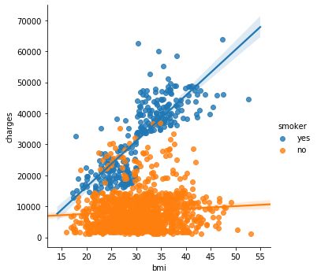
Do Age, BMI, and Smoke Effecting the Insurance Charges ?
Charges Smoke & Age
Charges Smoke & BMI

Slide 7
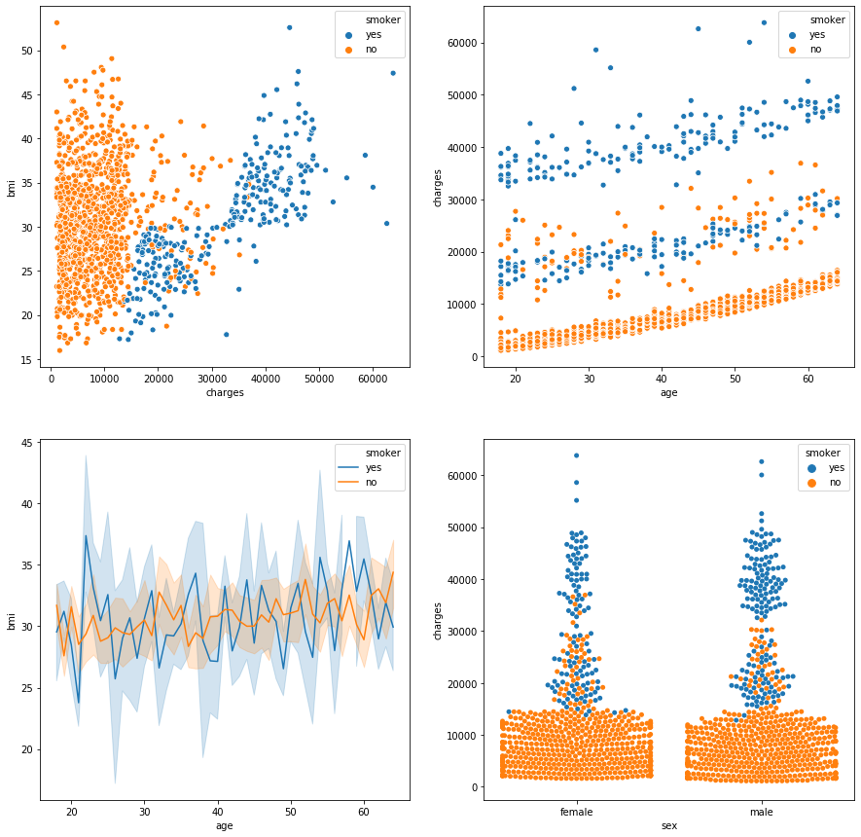

Slide 8
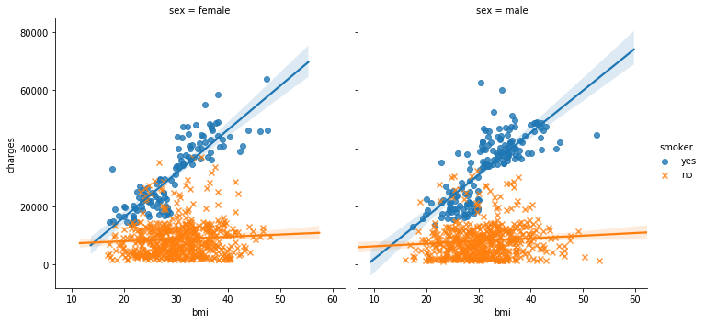
Observation:
From the graph shown:
“Do Age, BMI, and Smoke Effecting the Insurance Charges ?”
SMOKER affects the most in the insurance charges.
- Irrespective of high or low bmi if a person is a smoker its insurance charges is increasing Significantly.
- Which is Same for both Male and Female as below graph shows.

Slide 9
Observation:
Fig 1:
non smoker- In most cases the charges for non smoker is approximately starting from 2000 till 13000 which is in the range even if the bmi is increasing.
There are only few cases where charges are going high till 35000 between the bmi range 25 to 43.
smoker- The Maximum charger of non smoker is the min charges for a smoker as the graph shows smoking is highly affecting the charges.
The value of charges incresing rapidly with the increase in bmi, so there is a relation between smoker and bmi, with increase in bmi for smoker the chrges are also incresing.
Fig 2:
With increase in age there is a marginal increase in charges for smoker and non smoker few cases where its ranging from 12k to 30k.
As shown in figure the charges of smoker is high with respect to age.
Fig 3:
non smoker bmi is quite good as compared to smoker.
Fig 4:
This plot shows the charges for male and female with respect to smoke can see non smokers charges are low and number of count is high.
For smokers number of count is low but their charges are high.

Slide 10
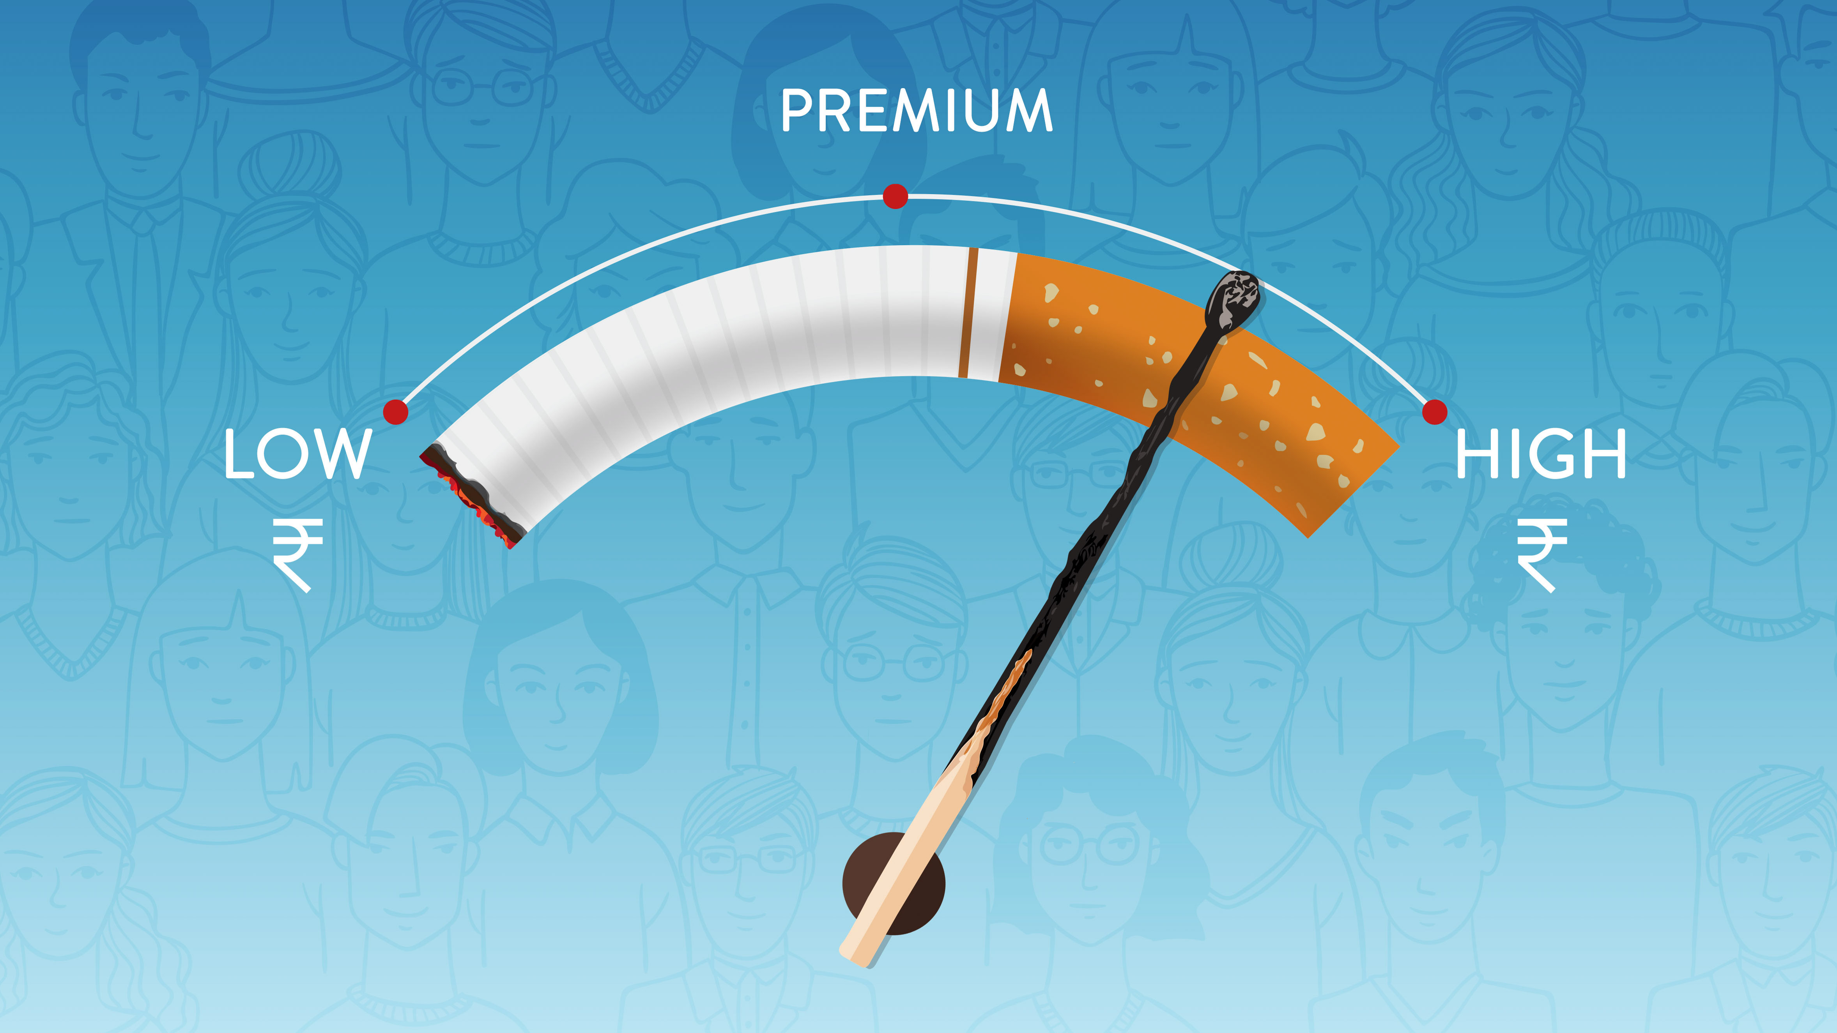
Smoking effects Insurance Premium

Slide 11
Applying ML Algorithm
For the current Insurance Data applying Linear Regression
In order to apply ML algorithm need to fix the data
Such as categorical columns should be converted to numerical columns
Modified all the categorical columns to numerical using Dummification
Data from different columns are of different values and scale, to perform calculation on the data need to transform the entire data to standard scale.
Post step 1&2, Splitting the data into explanatory and target variables
Explanatory Variable to be X Test and X Train data
Target variable to be the Y Test and the Y Train data
Performing the Prediction on the X Train Data
Calculating the Prediction score and the Error score
To check the performance nothing but Model Evaluation

Slide 12
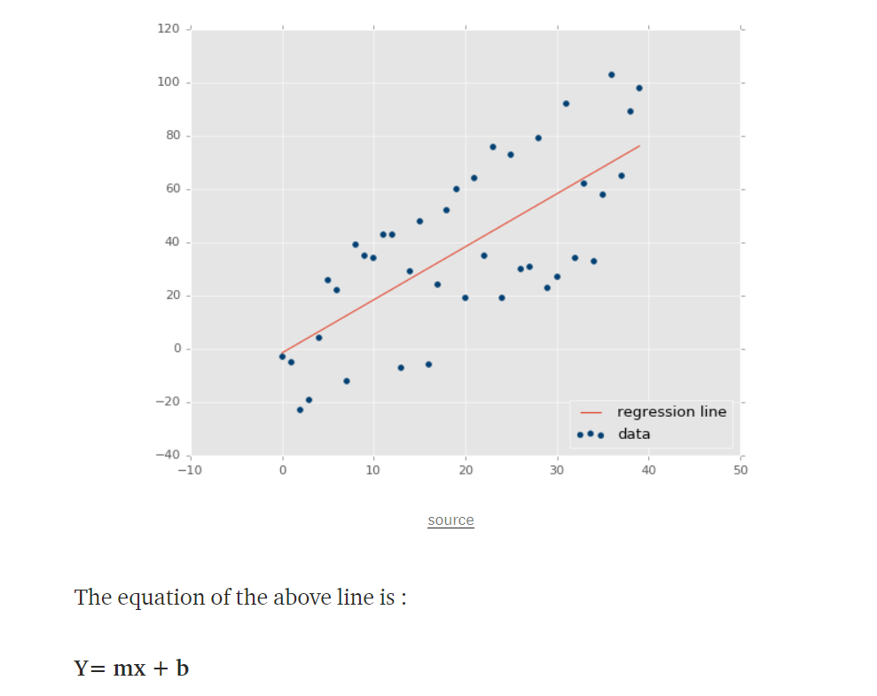
Intercept and Coefficients:
Intercept:0.0015
Coefficients:0.3003, 0.1705, 0.0461, -0.0063, 0.8007

Slide 13
Model Evaluation:
RMSE_train
0.4998184249795505
R Square
Adjusted R Square
0.7424681675658665
0.7472908610571425
RMSE_test
0.5033801809255821

Slide 14
THANK YOU

